Slide 1
Making things Work Together
QCon NY June 20, 2012

Slide 2
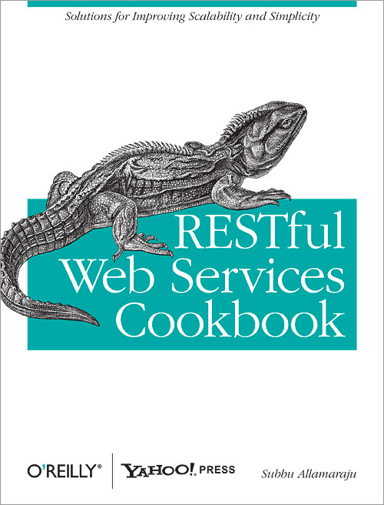

Subbu Allamaraju
@sallamar
github.com/s3u

Slide 3
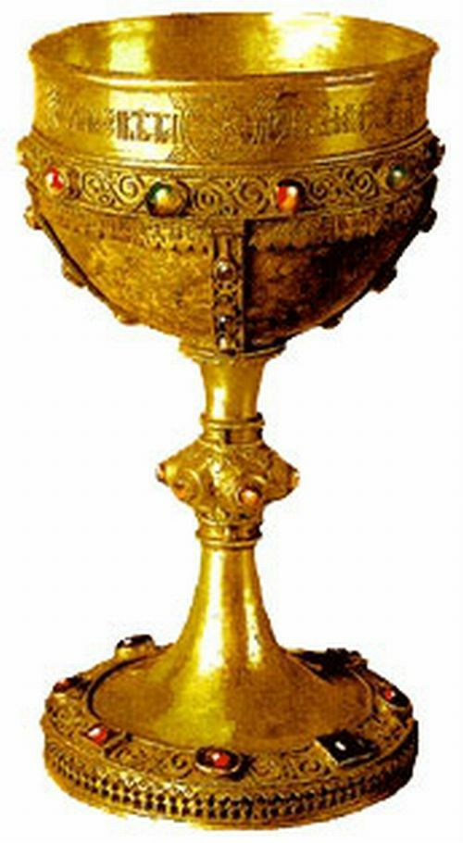
How to build an interoperable Programmable Web?

Slide 4

Agreements

Slide 5
Discovery
Linking, Identity
Schemas, Media Types
Formats
Interfaces (Uniform, RPC)
HTTP
TCP

Slide 6

Server's point of view

Slide 7
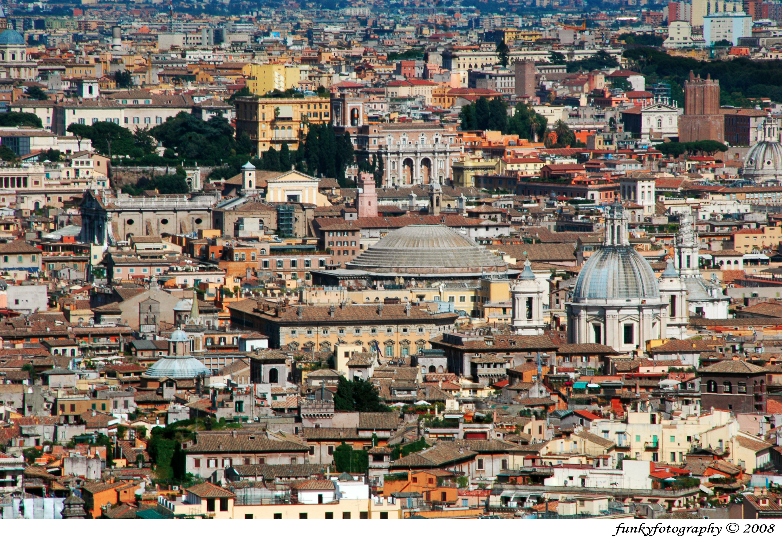
Client's point of view

Slide 8
Several hundred APIs
Different styles
Written by different teams
Over years
Built under different constraints
Built with different goals

Slide 9
Use case:
Find things from A
For each thing, find details from B
For each thing, find more details from C
Merge results

Slide 10
Use case:
Find products
Find dominant categories of products
Look up category info
Merge categories with products

Slide 11
Use case:
Get stuff from A
If A is down, try from B
Annotate stuff with other stuff from C
Ignore some things from the stuff
Join all

Slide 12
[Really important client]
Why don't you give me an API optimized for my use cases?
Client
Producers
[Really important producer]
Thanks. Get a number and stand in the line!
Server

Slide 13
[Really important client]
Why don't you give me an API optimized for my use cases?
Client
Producers
Who gets to decide the right thing?
[Really important producer]
Thanks. Get a number and stand in the line!
Server

Slide 14
Discovery
Linking, Identity
Schemas, Media Types
Formats
>
Interfaces (Uniform, RPC)
HTTP
TCP

Slide 15
Discovery
Linking, Identity
>
Schemas, Media Types
Formats
HTTP
TCP

Slide 16
>
Discovery
>
Linking, Identity
Formats
HTTP
TCP

Slide 17
Formats
HTTP
TCP

Slide 18
Latency
Smart Client
Code
Failure Recovery
Orchestration
IO
Formats
HTTP
TCP

Slide 19


Slide 20
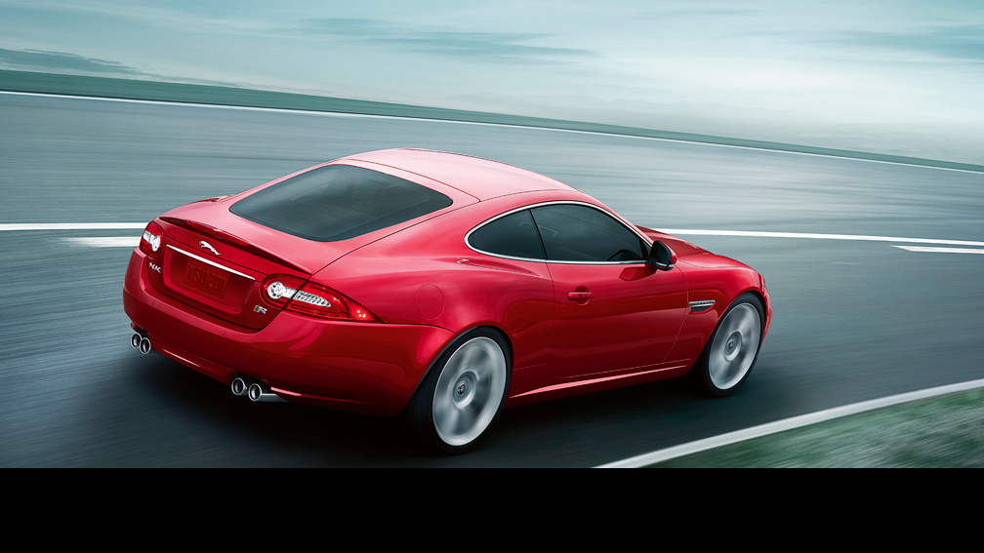

Slide 21

https://github.com/ql-io/ql.io
Platform Engineering

Slide 22
A domain specific language for HTTP client programming

Slide 23
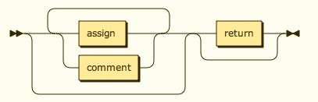
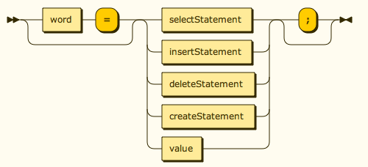
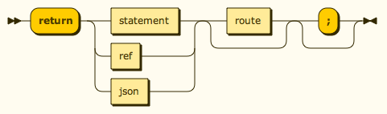

Slide 24
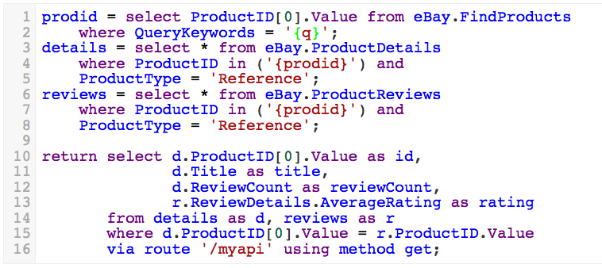

Slide 25
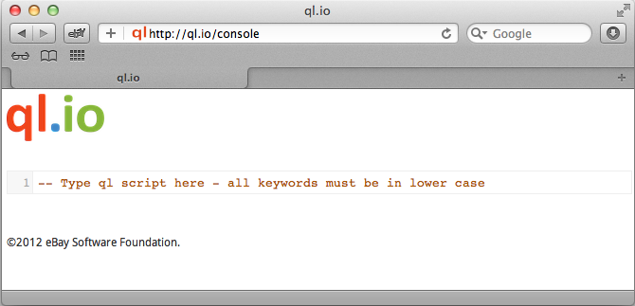
http://ql.io/console

Slide 26
A runtime designed for IO workloads
Runs on node.js

Slide 27
1. Interop via HTTP
Support the protocol – but don't require style adherence

Slide 28
create table mytable1
on select
get from 'http://...';
create table mytable2
on insert
get from 'http://...&do=create'
create table mytable3
on delete
post to 'http://...'
using headers 'X-Do' = 'Delete'

Slide 29
2. Interop using common formats
Agnostic of domain specific type systems

Slide 30
/* A table with a body template */
create table bing.soap.search
on select post to 'http://api.bing.net/soap.asmx'
using defaults appid = 'xxx'
using bodyTemplate 'bing.xml.mu'
type 'application/xml'
resultset 'soapenv:Envelope.soapenv:Body.SearchResponse.parameters.Web.Results.WebResult';

Slide 31
<soapenv:Envelope xmlns:soapenv="http://schemas.xmlsoap.org/soap/envelope/">
<soapenv:Header/>
<soapenv:Body>
<SearchRequest xmlns="http://schemas.microsoft.com/LiveSearch/2008/03/Search">
<parameters>
{{#params}}
<Query>{{q}}</Query>
<AppId>{{appid}}</AppId>
{{/params}}
<Sources>
<SourceType>Web</SourceType>
</Sources>
</parameters>
</SearchRequest>
</soapenv:Body>
</soapenv:Envelope>

Slide 32
-- Form encoded body
create table mytable
on insert post to 'http://...'
using bodyTemplate 'somefile.txt'
type 'application/x-www-form-urlencoded'
-- Or JSON
create table mytable
on update put to 'http://...'
using bodyTemplate 'file.json' type 'application/json'

Slide 33
create table {a name}
on {select|insert|update|delete}
{get from|post to|
put to|delete|patch}
{a URI template}
using headers {name}={value}*
using bodyTemplate={a file}
type={media type}

Slide 34

create table {a name}
on {select|insert|update|delete}
{get from|post to|
put to|delete | patch}
{URI template}
using headers {name}={value}*
using bodyTemplate={a file}
type={media type}
HTTP method
URI template
Headers
Body
Media type

Slide 35
-- A table with a monkey patch
create table bitly.shorten
on insert get from "..."
using patch 'bitly.js'
on select get from "..."
using patch 'bitly.js'
/* bitly.js A Javascript monkey patch */
exports['patch status'] = function(options) {
return args.body ?
args.body.status_code : 200;
};

Slide 36
3. SQL inspired constructs
CRUD operations, filtering, joins

Slide 37
-- Get the complete response as JSON
select * from google.geocode where
address = 'Brooklyn, NY'
-- Project fields
select ProductID[0].Value,
DetailsURL, StockPhotoURL
from eBay.FindProducts
where QueryKeywords='mini cooper'

Slide 38
/* Join datasets without enforcing identity
across systems */
select e.ItemID as id, e.Title as title,
e.ViewItemURLForNaturalSearch as url,
g.geometry.location as latlng
from details as e, google.geocode as g
where e.itemId in (select itemId from
finditems where keywords = "iPad")
and g.address = e.Location

Slide 39
4. Orchestration
Implicit sequential, scatter, parallel, forks and joins

Slide 40
-- Sequential
minis = select * from finditems where
keywords = 'mini cooper' limit 10;
return select PictureURL from details where
itemId = "{minis.itemId}";
-- Or parallel
keyword = "ql.io";
web = select * from bing.search where q = "{keyword}";
tweets = select id as id, from_user_name as user_name,
text as text from twitter.search where q = "ql.io";
return {
"keyword": "{keyword}",
"web": "{web}",
"tweets": "{tweets}"
}

Slide 41
prodid = select ProductID[0].Value from eBay.FindProducts
where QueryKeywords = 'macbook pro';
-- Scatters "n" requests
details = select * from eBay.ProductDetails where
ProductID in ('{prodid}') and
ProductType = 'Reference';
-- Scatters "n" requests
reviews = select * from eBay.ProductReviews where
ProductID in ('{prodid}') and
ProductType = 'Reference';
-- Gather, merge, and join
return select d.ProductID[0].Value as id,
d.Title as title, d.ReviewCount as reviewCount,
r.ReviewDetails.AverageRating as rating
from details as d, reviews as r
where d.ProductID[0].Value = r.ProductID.Value

Slide 42
-- An API that takes one ID at a time
create table eBay.ProductDetails
on select get from "...&...={^ProductID}"
...
resultset 'Product';
-- A batch API – takes upto 20 IDs
create table details
on select get from "...&ItemID={20|itemId}
...
resultset 'Item';

Slide 43
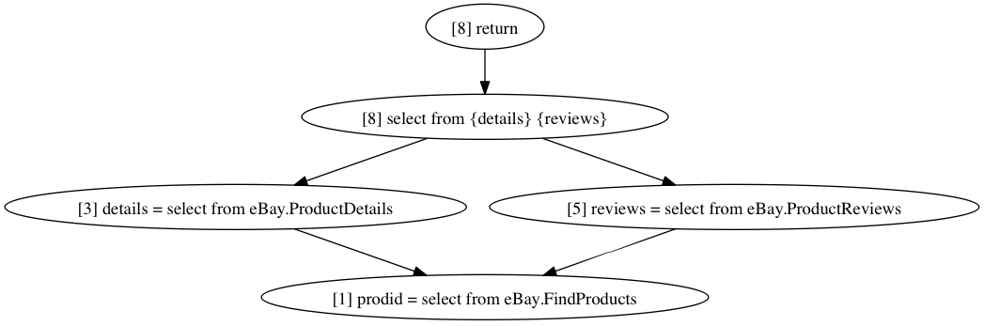

Slide 44
5. Failure Modes
Timeouts, back-off and recovery

Slide 45
-- Timeout on idle sockets
-- Retry once for idempotent statements
select id, img from recommendations
timeout 100
-- On three successive failures, backoff
-- for 100 – 2000 msec
select id, img from recommendations
timeout 100 minDelay 100 maxDelay 2000

Slide 46
-- Use a fallback
select id as id, item_url as img
from recommendations
timeout 100
||
select ID as id, deal_url as img
from deals;

Slide 47
6. Interface
Consumer-specified

Slide 48
var Engine = require('ql.io-engine'),
fs = require('fs');
var engine = new Engine({
tables : __dirname + '/../tables',
config: __dirname + '/../config/dev.json'
});
var script = fs.readFileSync(__dirname + '/some.ql', 'UTF-8');
// Exec the script
engine.execute(script, function(emitter) {
emitter.on('end', function(err, result) {
result.body.forEach(function(row) {
console.log(row);
});
});
});

Slide 49
Push orchestration to the data center
Reduce HTTP requests
Reduce bandwidth use

Slide 50
/* Shows daily deals - use siteId=0 for US and siteId=3 for UK. */
resp = select * from dailydeals where siteId="{siteId}";
deals = "{resp.$..Item}";
itemDetails = select ItemID as itemId, Title as title,
GalleryURL as pic, Seller.UserID as sellerUserId,
Seller.FeedbackScore as rating,
Seller.PositiveFeedbackPercent as feedback,
HitCount as hits from details
where itemId in (deals.ItemID);
return itemDetails via route '/deals/{siteId}' using method get;

Slide 51
Latency
Failure Recovery
Orchestration
IO workloads
Server
Formats
HTTP
TCP

Slide 52
code
https://github.com/ql-io/ql.io
docs/demos
http://ql.io
blog
http://ql-io.github.com

